Slide 1
Analysis of Current Assistive Cooking Technology and Needed Future Components
Alexander Spivey and Merritt Cahoon

Slide 2
Objectives of the Presentation
Present a survey of current field
Explain primary focuses of research
Inclusivity and Independence
Simulation Overview
Future research focuses
Notes:
Alexander Spivey

Slide 3
Section 1.
Prior Research
Abstract
How assistive robots can assist differently-abled prepare meals.
Analyze and critique current research trends
Create a multi-disability friendly device
Focus on issues of older or differently-abled people
Imperative to improve lives
Notes:
This first section is focused on prior research conducted within the cooking assistive tech field. We will cover current state-of-the-art cooking robots and provide context on how assistive robots can provide help to people with disabilities in preparing meals.
We will analyzes the trends, capabilities, and patterns that have appeared and critique malpractices and outdated concepts.
One of the primary focuses of this section is to stress how cooking systems need to be all-encompassing and inclusive
We will highlight the barriers faced by people with disabilities -and demonstrate how their lives could benefit from the popularization and mainstream production of cooking assistive technologies.
We conclude that research in assistive technology is imperative for household chores to relieve the strain on people with disabilities to ensure independence in the home with the benefit of aid.
43 s

Slide 4
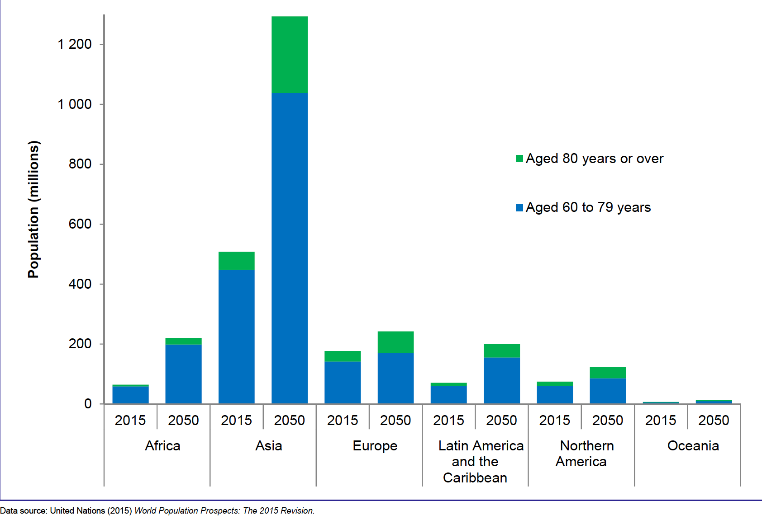
21.5%
[1]
is the expected population of elders by 2050
Notes:
Alexander Spivey
Even though one might not think it at first, aging is considered to be one of the most prominent disabilities due to how it whittles away one’s abilities and increases there limitations. According to the UN, the percentage of the global population aged 60 years or older rose from 8.5 percent in 1980 to 12.3 percent in 2015, with that number projected to rise past 21.5 percent by 2050, which can be seen in Fig. 1 [1]
Next page as well: 1:07seconds

Slide 5
8 Main Obstacles
[2]
Social isolation
Dependent living
Physical or cognitive impairment
Mobility problems
Inadequate health monitoring
Lack of recreation
Reminding problems
Fall problems
Notes:
Alexander Spivey
As a new wave of older adults start shying away from nursing homes, studies have increased to create robots with specific parameters to operate within the average household. As of now, there are eight main obstacles to face for those who want to age in place or suffer from disabilities:
Currently, there is a wide range of cooking robots that have been produced, with a few explicitly made with disabilities in mind. By broadening the capabilities of these current systems through analysis and modification, it could allow a single device to be mass manufactured and used by most types of differently-abled people.

Slide 6
Chinese Cooking Robot
[3]
Automatic loading, cooking, serving, and self-cleaning
Pre-portioned delivery service
Telescope, RFID-Transceiver, Grabbing Manipulator
Three hundred dishes “typical for the aged”
Rotary table through centrifugal motor
Notes:
Chinese researchers were able to create a complete kitchen robot for people with disabilities that had four main functions: automatic loading of ingredients, cooking, sending of dishes, and self-cleaning.
In addition to automatic loading, ingredients are also delivered pre-portioned and pre-cut in a box component to lessen the strain. When the customer wants a specific meal, a telescope and RFID (radio frequency identification) transceiver will read an RFID tag to determine whether the components for that meal are present, available, and within the specific ingredients expiration date. The grabbing manipulator loads the ingredients into the cooking modul after its prep. The system can perform basic Chinese cooking techniques (such as the toss, stir, and flip), automatically put raw ingredients into the wok, and cook the food equally.
The robot can cook over three hundred Chinese dishes “typical for the aged”, giving users familiarity and comfort with their meals.
To automatically deliver cooked dishes, a rotary table is attached to the robot. This table is raised and can hold multiple dishes simultaneously without causing extra strains on the user by allowing rotation. After the cooking process is complete, the robot will then begin the automatic cleaning process. The wok, the stirring tool, the wok cover, and the sink will all clean themselves.

Slide 7
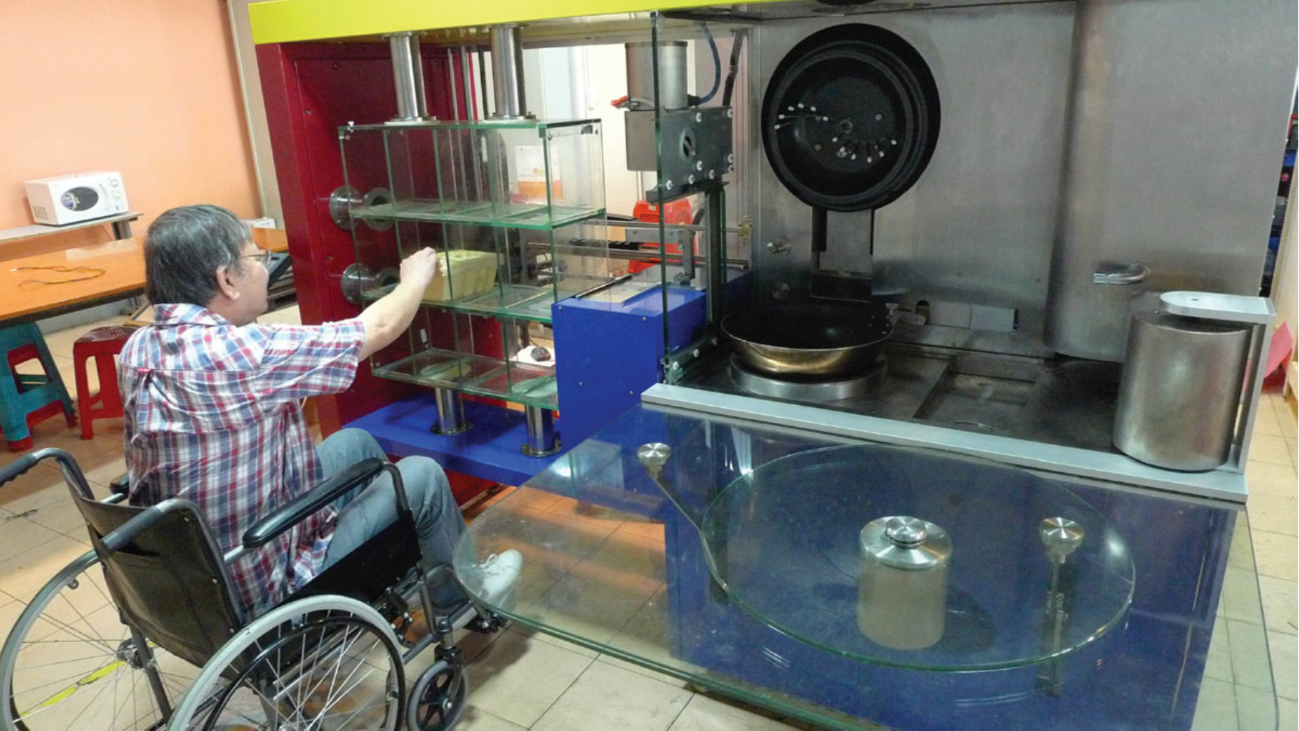
Chinese Cooking Robot cont.
[3, 4]
Dimensions:
2.295 m (length)
0.770 m (width)
2.000 m (height)
Size too cumbersome for most kitchens
Too capable / lack independence
A picture of the chinese cooking robot for elders [3].
Notes:
For a robot to perform these tasks, it needs plenty of space to do so. One of the major cons to this system is its overwhelming size. The dimensions of the robot, excluding the fume treatment module and the touch screen system, are 2.295 m in length, 0.770 m in width, and 2.000 m in height. For someone with a smaller kitchen or a larger wheelchair, the robot’s size can create mobility issues for the user. In the conclusion of their article, the author states that its size was too cumbersome for most kitchens.
The abilities of this cooking robot are essential for people with disabilities but allow very little independence in the cooking process. For older adults who prefer to age in place, independence is essential, and customization in the amount of help the robot provides is vital to allow accessibility for people with all ranges of disabilities.

Slide 8
Augmented Reality Supported Induction Cooker
[5]
Made for people who lack culinary skills
Trains cooking candidates within culinary school
Gives thorough instructions through virtual assistant
Induction technology: energy efficiency & hygienic cooking
Stores nutrition data on IoT network
Upgrades AR-SI: automatic cutting & stirring systems
Notes:
Alexander Spivey
In Switzerland, an AR-Supported induction (AR-SI) cooker prototype has been created to aid the user within the cooking process while still allowing independence [5].
The AR-SI cooker promotes healthier gastronomy by creating and assisting the user with a simplified, healthy recipe.
It’s three main priorities are to: help regular people who lack culinary, train cooking candidates within a culinary school, and upgrade it in due time
The system is led by a virtual assistant that’s built on AR with AR support to give detailed steps and instructions on following the recipe step by step.
It also takes into account weight control and presents a 3D visualization of the cooker and pan.
38seconds

Slide 9
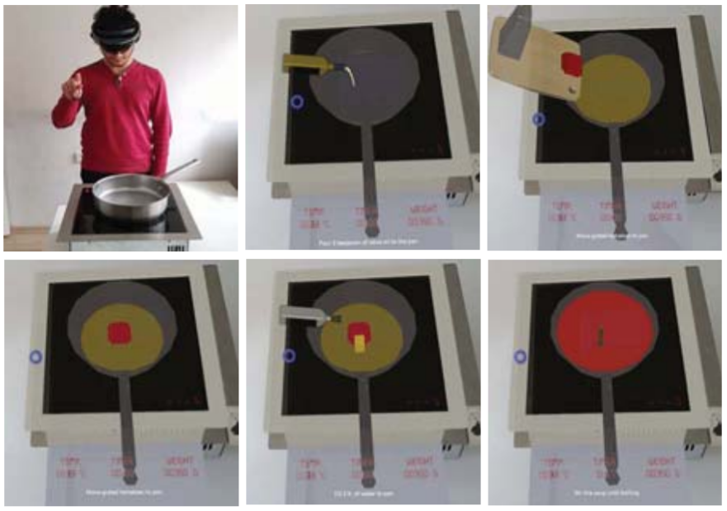
Fig. 3 A collage of pictures demonstrating the process of cooking tomato soup by AR-SI cooker [5].
Notes:
Alexander Spivey
The AR-SI cooker has a primary weight sensor and monitors the ingredients' weight to ensure each ingredient is appropriately proportioned.
With the use of the weight sensor, users can cut down on food waste
The system uses induction technology which is significantly safer to use
This cooker also assists in promoting accessible and efficient healthy eating by storing nutrition information through an IoT (Internet of Things) network.
Due to this, it can keep up with data like consumed power, food temperature, and food amount.
The AR-SI is only just a preliminary step; however, with time, the integration with food robots by adding automatic cutting systems will allow for even more efficient systems.
37seconds

Slide 10
RAMCIP
[6]
Initiative to share responsibilities with caregivers
Supports assistance provision for daily activities
Developed methods: unobtrusive human activity recognition
identify intricate human actions
behavior of multiple personals
Reduces dependence on human caregivers & hospitals
Live demonstrations continue while towards commercialization
Notes:
RAMCIP is an EU funded project that targets and combats the increasing need for elderly care services at home.
It stands for Robotic Assistant for patients with Mild Cognitive Impairments and resulted from this initiative to share responsibilities with human caregivers
It focuses on developing high-level cognitive functions to enable proactive robotic behavior and it also can support assistance provision for daily activities, like cooking, eating, medication supply, and securing safe handovers.
Researchers also developed methods for unobtrusive human activity recognition to identify intricate human actions and the behavior of multiple personals within the user's home. The conclusions of this method aid the robot's performance in cooking, housekeeping, detecting forgotten actions by the user, and emergencies like falls.

Slide 11
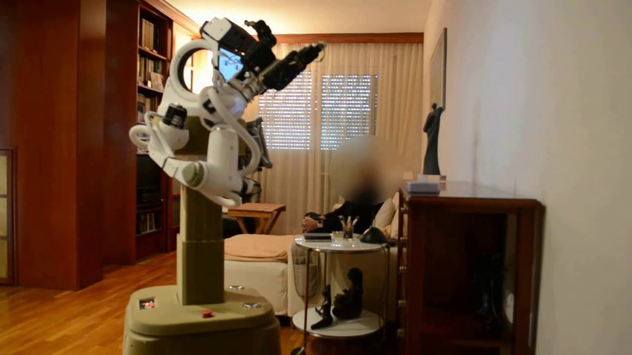
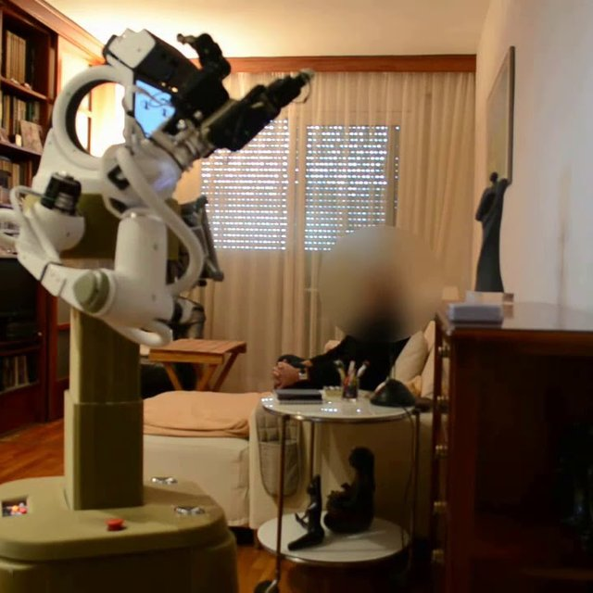
Fig. 4 A picture of the RAMCIP robot. User’s face was blurred for privacy reasons [7].
Notes:
Users can effectively communicate with the system through an interactable touchscreen, speech, and gestural modalities.
It can also fetch and grasp an assortment of objects that cannot be reached by the user safely, from small items to dishes and cooking utensils and can interact with other home environments such as doors, light switches, and ovens.
Live demonstrations of RAMCIP continue while looking into ways to commercialize the service robot.
Project Coordinator Dimitrios Tzovaras stated that this project helps reduce the dependence on a human caregiver for elders and time spent in hospitals and institutionalization.
Although RAMCIP is not primarily considered a cooking robot, its versatility through a combination of methods to assist is vital to allow relief and service for a wide range of disabilities.

Slide 12
Section 1a.
Interface
Definition
A device that enables communication between the user and the computer
Notes:
Alexander Spivey
After analyzing the previously mentioned robots, the following section pertains to different components of a “perfect” cooking system.

Slide 13
Autonomous Narration
[8]
Functional autonomy:
“integrating, perception, action, planning, & learning capabilities”
inability to explain or demonstrate their internal process.
three-layered model as retrievable episodic memory
Speech parameters:
Learning algorithm with recall to specification
Limited to task, has higher-level thinking
Notes:
Alexander Spivey
Most robots can now function to the point of autonomy due to their “integrating, perception, action, planning, and learning capabilities” [8].
One issue that is still apparent is their inability to explain or demonstrate their internal process. Researchers from Carnegie Mellon University “propose a three-layered model to represent robot experience which doubles as a retrievable episodic memory.”
This episodic memory functions as an internal memory bank, allowing the robot to give the same narration if unchanged parameters.
A learning algorithm stores information and recalls the necessary parts to fit the user’s specifications.
This verbalization system is limited to the current task but can include higher-level thinking if required, such as grasping the tool most effectively to execute the task.

Slide 14
Autonomous Narration cont.
[9,10]
Upgrades
Neural network; modify speech to qualifications.
Learning algorithm; intakes natural language corpus
Benefits:
Narration allows peak into system processing
Practice dictation, memory retention, & active listening
Verbalization system can help simulate conversing
Programs to communicate using built-in sensors
Notes:
Alexander Spivey
The researchers hope to add a neural network to the verbalization system to automatically analyze conversations between the robot and user, allowing the robot to modify its speech syntax to fit the user’s qualifications. Additionally, they hope to conceive a learning algorithm that intakes a natural language corpus to refine the current verbalization models to sound more natural and have more range and options for the verbal specifications.
By effectively narrating the steps taken, users could build more trust in intelligent systems, allowing them to sneak peek into the overall system’s thought and action processing [9]. In doing so, patients who work alongside it can practice their dictation, memory retention, and active listening skills. The process could significantly help patients with cognitive issues, such as dementia or Alzheimer’s. For those who may not need constant caretaker, sometimes the elderly are often left unaccompanied for times, especially if they are within the lower economic brackets. Adding a verbalization system can help simulate conversing, which could lead to lower depression and loneliness, drastically altering the user’s health for the better [10]. Additionally, the robot could potentially be modified in time to be multipurpose by utilizing the builtin speakers and microphone to access commercially used communication software to broaden the users point of contact.

Slide 15
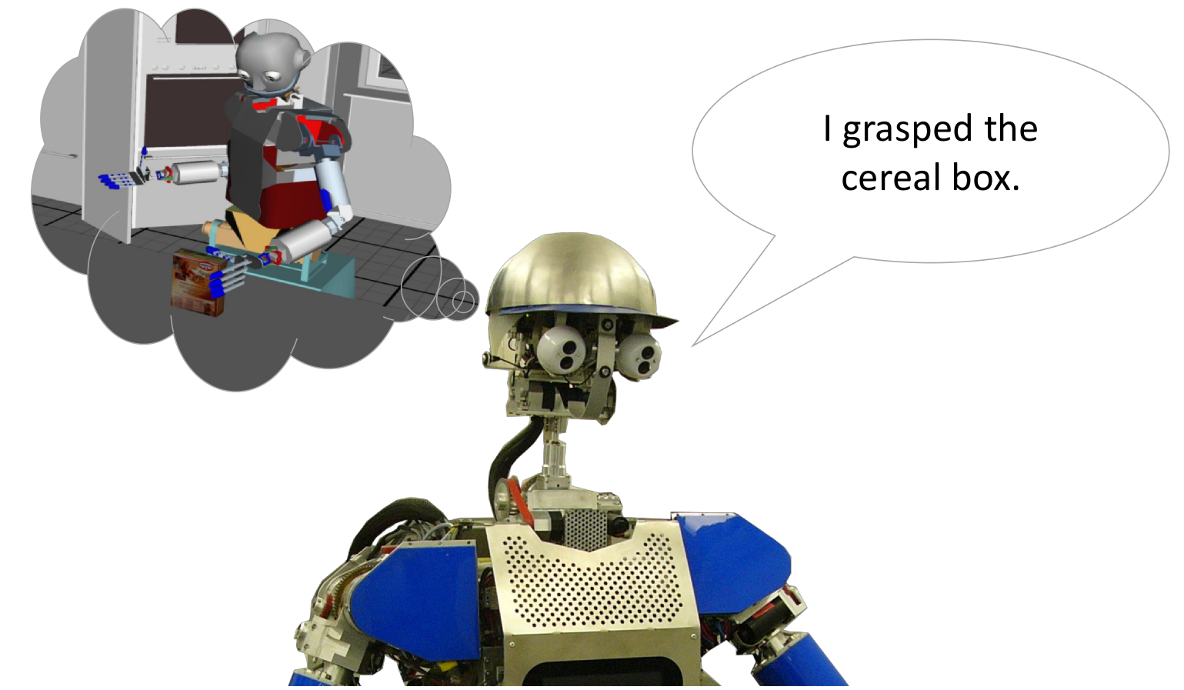
Fig. 5 The verbalization system generates a natural language description based on recorded experience during task execution of the robot [8].
Notes:
Alexander Spivey

Slide 16

20%
[11,12,13]
of the world population is affected by cognitive deficiency
Notes:
Currently, approximately 20 percent of the world population is affected by cognitive deficiency.
Deficiencies can cause difficulties in learning, remembering information, and decision-making due to genetic conditions, injuries, or age-related effects.
The “United Nations Convention on the Rights of Persons with Disabilities” expresses that the fundamental human rights of people with cognitive disabilities need preserving, and that includes their right to independent living. Living facilities have started to foster and train independent living skills to protect those rights, including cooking.

Slide 17
In-Situ Assistance
Regular Caretaker Assistance
Strictly auditory instructions and assistance
In-Situ Assistance
Auditory instructions
Looped videos demonstrating tasks
Contour projections displayed on/around objects of interest
Progress bar made available by projection
Notes:
A study in Germany compared the time it took for cognitively impaired users to prepare a meal and their cooking performances between regular caretaker assistance and in-situ assistance to test how to effectively help people with cognitive deficiency perform tasks.
Caretaker assistance was strictly auditory.
The in-situ assistance included auditory instructions, looped videos with how to complete each recipe task, and contour projections displayed on or around objects of interest in the current cooking step. Additionally, a progress bar is made available by projecting the overlay onto the hot plate.

Slide 18
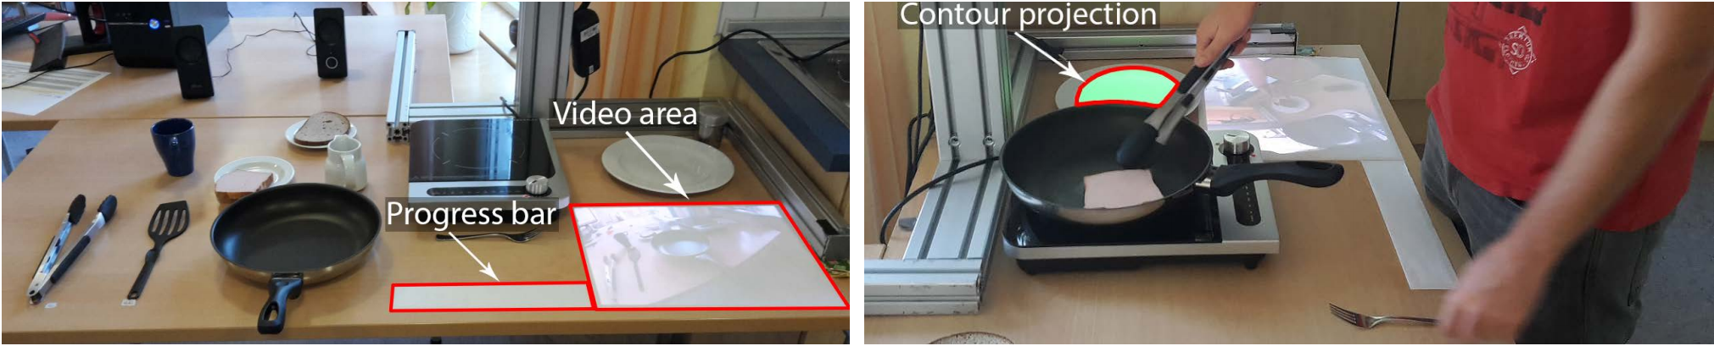
Figure 6. A picture of the visual output modalities of the cooking instruction system [14]

Slide 19
[14]
In-Situ Assistance
Compared performances for cognitively impaired users
Regular caretaker assistance vs. in-situ assistance
In-situ complements cognitive processing of instructions
Proving simultaneous feedback assist users greatly
Notes:
After a two-week-long trial, the study measured longer meal preparation times using in-situ assistance compared to caretaker assistance. However, the cooking times with the caretaker assistance in the second week using the same recipe improved significantly after employing in-situ assistance the week before.
With typical cooking instructions lacking multi-sensory use, visual feedback generated by in-situ assistance seemed to complement the cognitive processing of instructions, proving that simultaneous feedback from a robot can assist users greatly during the cooking process.

Slide 20
Section 1b.
Mechanics
Definition
Vital components needed for implementation within a perfect system
Notes:
Alexander Spivey

Slide 21
Japanese Text-to-Recipe Analysis
[15]
Recipes must be pre-programmed beforehand.
Takes considerable amount of resources.
Computes ingredients and motion-planning from text.
Separates motion code from recipe data
Better procedural generation within simulation program
Tests likelihood beforehand and modifies errors
Notes:
Alexander Spivey
Even though the number of cooking robots has exponentially increased in the past few years, they still must be programmed beforehand with a set number of recipes.
These recipes often take a considerable resources to code.
To counteract this issue, a recipe analysis program was made to analyze recipes online and then convert them into data for automated cooking.
The program will not only be able to devise the ingredient and cooking specifications, but it will also be able to interpret and analyze the text for clues on how to motion plan the entire procedure.
By separating recipe data and motion code from the recipe, it allows the system to more effectively break down the collected metadata and allow for better procedural generation within the robots-assisted simulation program, which tests the likelihood of success beforehand and then sends the approved instructions to the physical copy.
45seconds

Slide 22
Japanese Text-to-Recipe Analysis cont.
50% success rate
[15]
Errors:
recipe’s textual content (40%)
lack of content in the database (33%).
“Nearly 70% of the failures were due to a lack of unique expressions and proper nouns in the database” [15].
Notes:
Alexander Spivey
What truly is exemplary about this algorithm is its capability to analyze different Japanese dialects and syntax and still manage to interpret most of the recipe.
The result was a 50% success rate on 50 randomly chosen recipes, with most errors that it ran into due to the recipe’s textual content (40%) and lack of content in the database (33%).
With “nearly 70% of the failures were due to a lack of unique expressions and proper nouns in the database” [15].
25seconds

Slide 23
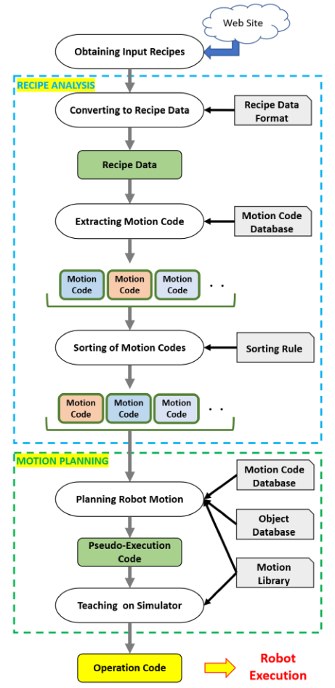
Fig. 7 A picture of the automated conversion process of natural language recipes to recipe data and motion planning [15].
Notes:
Alexander Spivey
The overall process starts from first obtaining the input recipe online, applying the data format to the recipe, converting it to recipe data, extracting motion code, sort the motion code, plan robot motion, pseudo-execution code, modify the simulation a bit, output the operation code, then finally, the robot is now able to execute the recipe.

Slide 24
“Scene understanding is defined by extracting six-W information such as What, When, Where, Who, Why, and hoW on the surrounding environment”
[16]
Notes:
Alexander Spivey
For recipes to be effectively followed and meals made without mistake, it is crucial for the audio-visual scene understanding of the autonomous assistive technology to be implemented with scene understanding capabilities. “Scene understanding is defined by extracting six-W information such as What, When, Where, Who, Why, and hoW on the surrounding environment” [16].

Slide 25
Scene understanding cont.
[16]
Most important & demanding to extract: “hoW”
“Audio-visual multimodal recognition” - recognizes actions
“Utilizing cooking knowledge from websites” - plans motion-map
Needed Information:
Camera; dead angles
Mic; noisy kitchen
Notes:
Alexander Spivey
The most important and demanding to extract of the six-Ws is “how.”
Researchers from Tokyo extracts “how” from a cooking scene by breaking down the process into two different modules: the first recognizes actions, such as “sliced bread,” and the second module extracts and plans a motion map based on the first layer of action.
These two factors are considered as “Audio-visual multimodal recognition & Utilizing cooking knowledge from websites.”
The most common method to collect and analyze visual data is through cameras, but often leaves the robot lacking required information due to dead angles and object-passing in front of the camera. Due to this, the robot must intake audio-based information as well to compensate.
35seconds

Slide 26
Scene understanding cont.
[17, 18, 19, 20]
Special cooking devices with separate built-in mics
(CNN) approach provides necessary occlusion-robustness.
Acquired online & converted to graph data structure,
Previously determined best fit
Graph data structure to Hierarchical Hidden Markov Model
“Probabilistic model to handle sequential data”
Notes:
Alexander Spivey
However, due to the noisy nature of a kitchen and its tools, special cooking devices with separate built-in mics must be used, giving the system multiple audio mapping of the same cooking scene.
For the visual scene to be understood, a convolution neural network (CNN) approach provides the system necessary occlusion-robustness. “A CNN is a Deep Learning algorithm which can take in an input image, assign importance (learnable weights and biases) to various aspects/objects in the image and be able to differentiate one from the other” [17].
The system’s action mapping is acquired from cooking recipe sites and then utilized after converting from natural language to a graph data structure, which has been pre-proposed in previous studies [18, 19].
The graph data structure is then converted into a Hierarchical Hidden Markov Model, “which is a probabilistic model to deal with sequential data such as the cooking process” [20].
48seconds

Slide 27
TABLE 1
Category | Stir-fried Vegetable
Ingredients | pork, onion, cabbage, green-pepper
Step
1 | Cut cabbage，carrot, and green-pepper into bite-sized pieces.Season the pork with pepper and cut it.
2 | Put the oil in a wok and stir-fry the ingredients for a few minutes. Serve.
Table example was provided by source [16].
This table represents the use of both Audio-Visual Multimodal Recognition (the listed category & ingredients) and Utilizing Cooking Knowledge From Websites (the generated steps/procedure)
Notes:
Alexander Spivey

Slide 28
Section 1c.
Customer Customization
Definition
The action of modifying something to suit a particular individual or task
Notes:
For a robot to be most effective in working with a person with disabilities, it needs to be explicitly tailored to the user.
The chance for users to customize their machine can help broaden the range of disabilities the machine can accommodate.
Not only does the robot need to be able to assist the user's needs, but it also needs to allow adjustment to the user's wants and tastes.

Slide 29
Bayesian Optimization
[21]
Automation in food industry is rapidly growing
faster, more reliable, cheaper ways of producing food
Home kitchen robots expected to be adaptable
Cook multiple recipes and adapt to user
Obtain quantifiable improvements for food optimization
Enhance taste, appearance & texture for future
Notes:
Automation in the food industry is a rapidly growing field
Industry cooking robots and personalized kitchen robots focus on very different things - the goal is to have faster, more reliable, and cheaper ways of producing food in the industry
In a home kitchen, robots are expected to be adaptable to cook multiple recipes and adapt to the user’s subjective preferences
Researchers from the University of Cambridge investigated algorithms for optimizing food quality measures like taste, appearance, and texture in preparing an omelet; beginning from an uncracked egg to plating the omelet.
They ran an experiment and used both batch and sequential Bayesian optimization and used four volunteers to rate the robot-made omelet on a scale from 1 to 10 on flavor, appearance, and texture.
Based on the rankings, the robot changed different variables like whisking, salt, cook time, mixing, and pepper. The results indicated that this methodology could obtain quantifiable improvements for food optimization

Slide 30
Food Delivery System
[3]
Create delivery company with digital recipe
Brings pre-portioned/pre-cut ingredients
Empty bin with used material
Load user’s refrigerators with ingredient boxes
Guarantee food hygiene with fresh ingredients
Reduce ingredients cost with less waste
Notes:
Chinese cooking robot:
introduces the idea of pairing a cooking robot with a food delivery system
The researcher’s idea is to create their own delivery company
Digital recipe couriers to bring pre-portioned and pre-cut ingredients and recyclable dishes
Couriers would arrive at the user’s home, empty the bin with used ingredients and dishes, and load the user’s refrigerator with new ingredient boxes
Process can guarantee food hygiene with fresh ingredients and reduce the cost of those ingredients with no waste involved from the portioning
Cleaning up after preparing a meal can be more complicated than cooking, which would require disposable plates and utensils, as well as a nonstick pan.
The current system suggests creating a specific company just for delivering, as it is a vital improvement in preparing a meal and cleaning up after it. Due to technological innovation since 2011, this technique can be simplified by attaching the robot’s capabilities with an existing food delivery service.

Slide 31
Kitchen Technologies for Ageing in Place
[22]
Important to securing bowls or cutting boards
Allows both hands for motions: stirring/cutting
Sensors keep track of kitchen items
System can support in maintenance/availability
Selects available tools to reinforce skills
Notes:
In Sweden, researchers documented data consisting of video recordings that observed senior volunteers following recipes they chose themselves.
Visual content analysis methods guided the analysis of the videos to identify the immediate help needed in the kitchen.
The main focus of the research was on physical manipulation, organization and coordination, and reorchestration and reorganization.
Analysts designed relief from the data for operational assistance to support practical operations of manipulating tools to complete actions in the kitchen and organizational assistance to help progression towards achieving the art of cooking.
The critical role for operational assistance is a system that can secure or stabilize items across the work surface to allow full use of dexterity. For example, having a bowl or cutting board secured enables the user to both hands during actions like stirring or cutting ingredients.
To encourage active and prosperous aging, adapting and coping to age-related changes is critical.
Sensors that can keep track of kitchen items and tools are encouraged so that the system can provide support in maintenance, availability, and selection of tools in a way that reinforces the user’s skills and competencies.
This assistance can aid in organizational assistance as well. During the cooking process, users have to keep up with a multitude of steps and items. Designing organizational assistance to keep track of locations of relevant objects and their movements during the process can optimize the simultaneous progression of different tasks and minimize movement in the kitchen space.
Cooking skills were central to older adults’ ability to live independently and contribute to successful and active aging.

Slide 32
Section 2.
Simulation Overview
Notes:
Alexander Spivey

Slide 33
Robot Simulation Intentions
Designed with inclusivity and disability in mind
Customizable options
Reduce size of system to not hinder mobility
Interface to instill trust in the system
Users: confident while remaining independent
Encourage practicing fine motor control
Adopting healthier gastronomy
Remaining aware of important upcoming events
Notes:
When we started thinking of ideas for what we wanted our simulation to be we kind of started by looking at the intentions for it

Slide 34
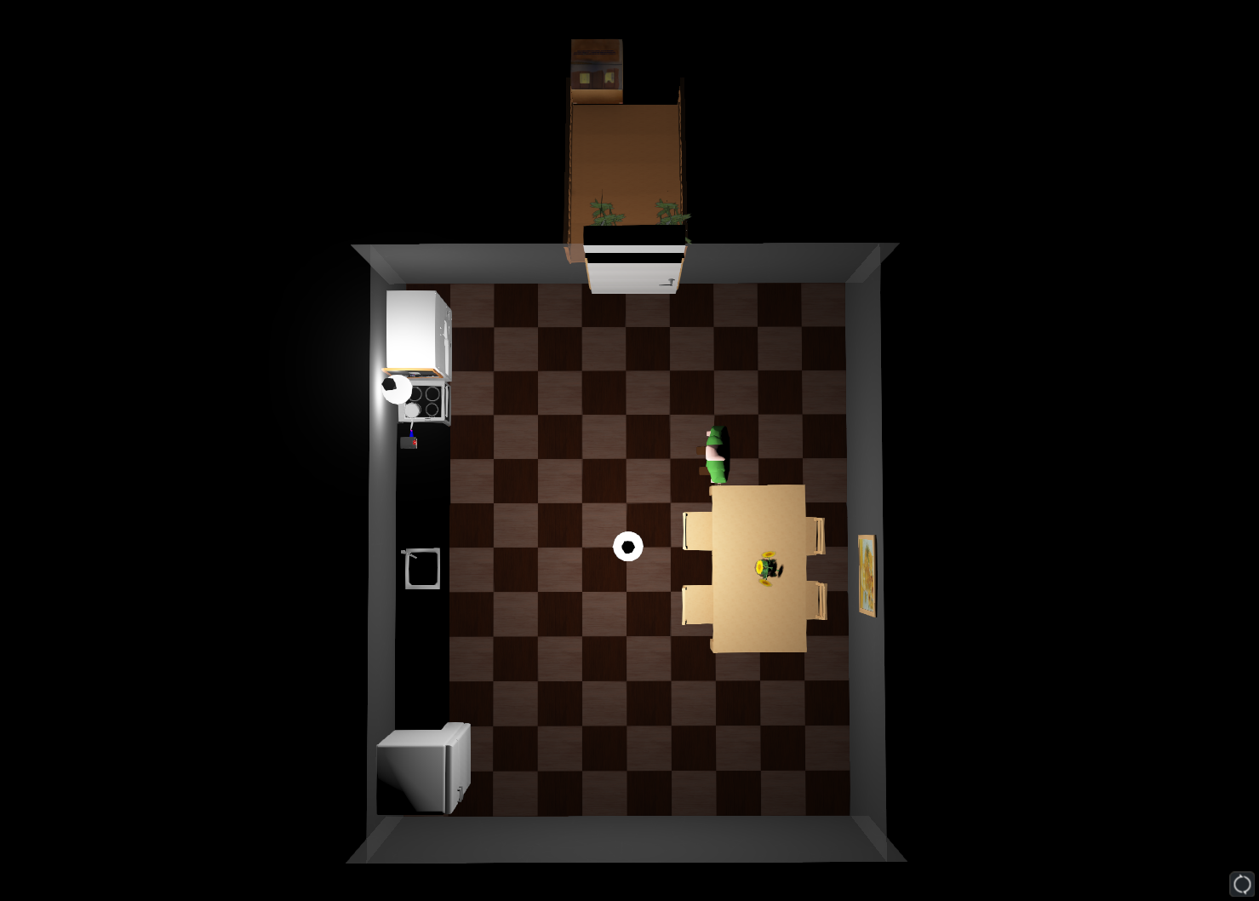
Delivery Box
Entrance
Cabinet
Stovetop
Human
The System
Counter
Sink
Decor
Dining Set
Fridge
Environment Simulation Overview
Notes:
Alexander Spivey

Slide 35
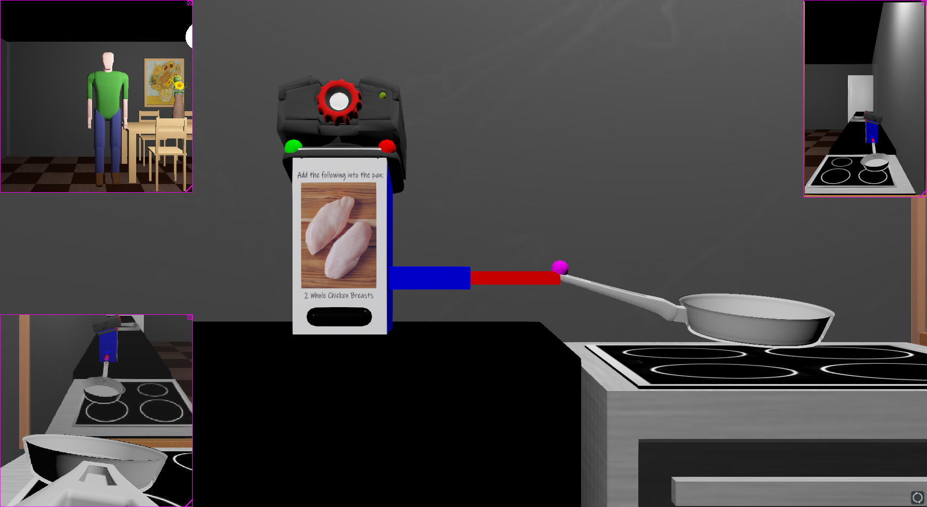
Webcam
Blue Arm: Move up and down
Red Arm: Move left and right
Green LED
Red LED
Pancam
Webcam Perspective
Mirror Perspective
Screen
Pan
Pancam Perspective
Speaker
Overview of System
Notes:
Alexander Spivey

Slide 36
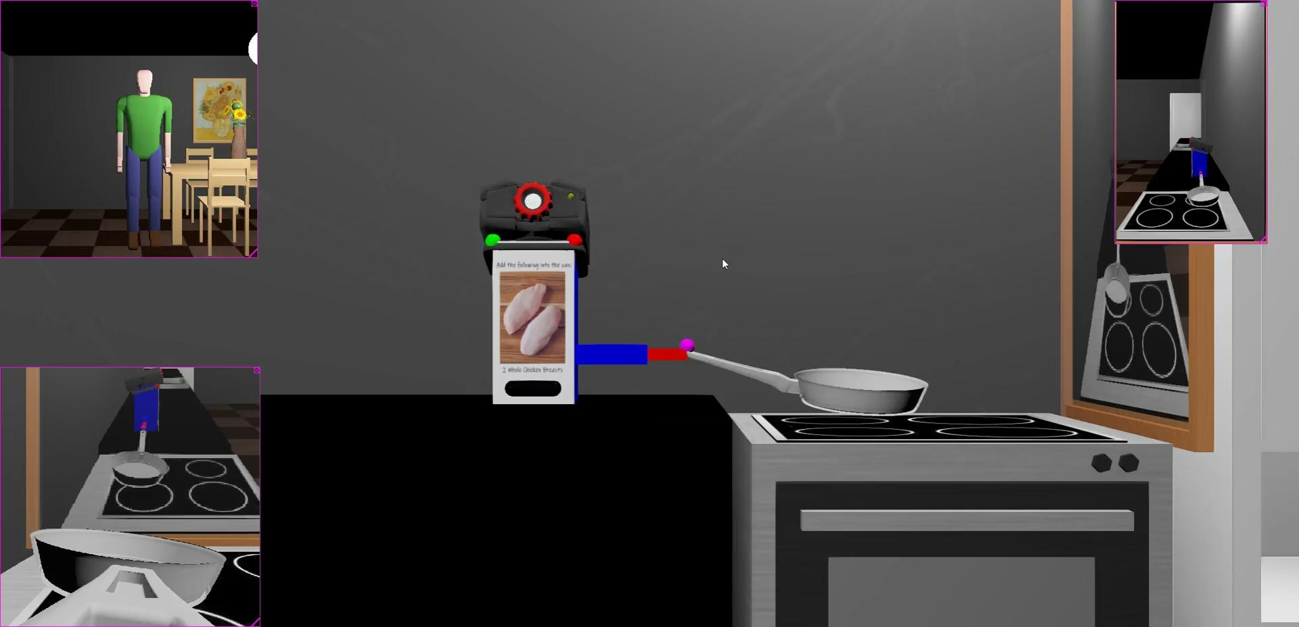
Linear Motion Overview
Notes:
Alexander Spivey

Slide 37
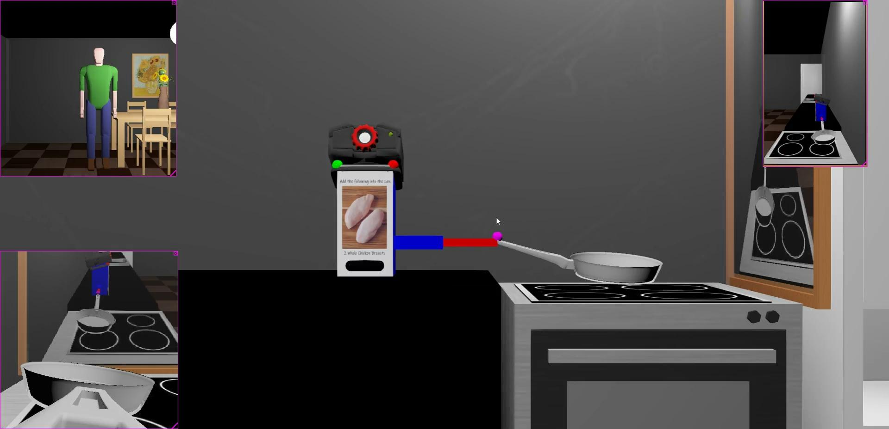
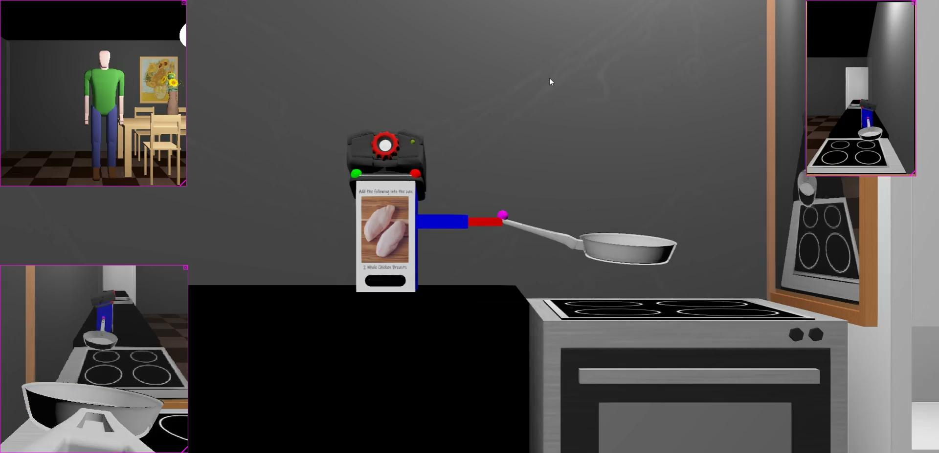
Diagonal Movement Overview
Notes:
Alexander Spivey

Slide 38
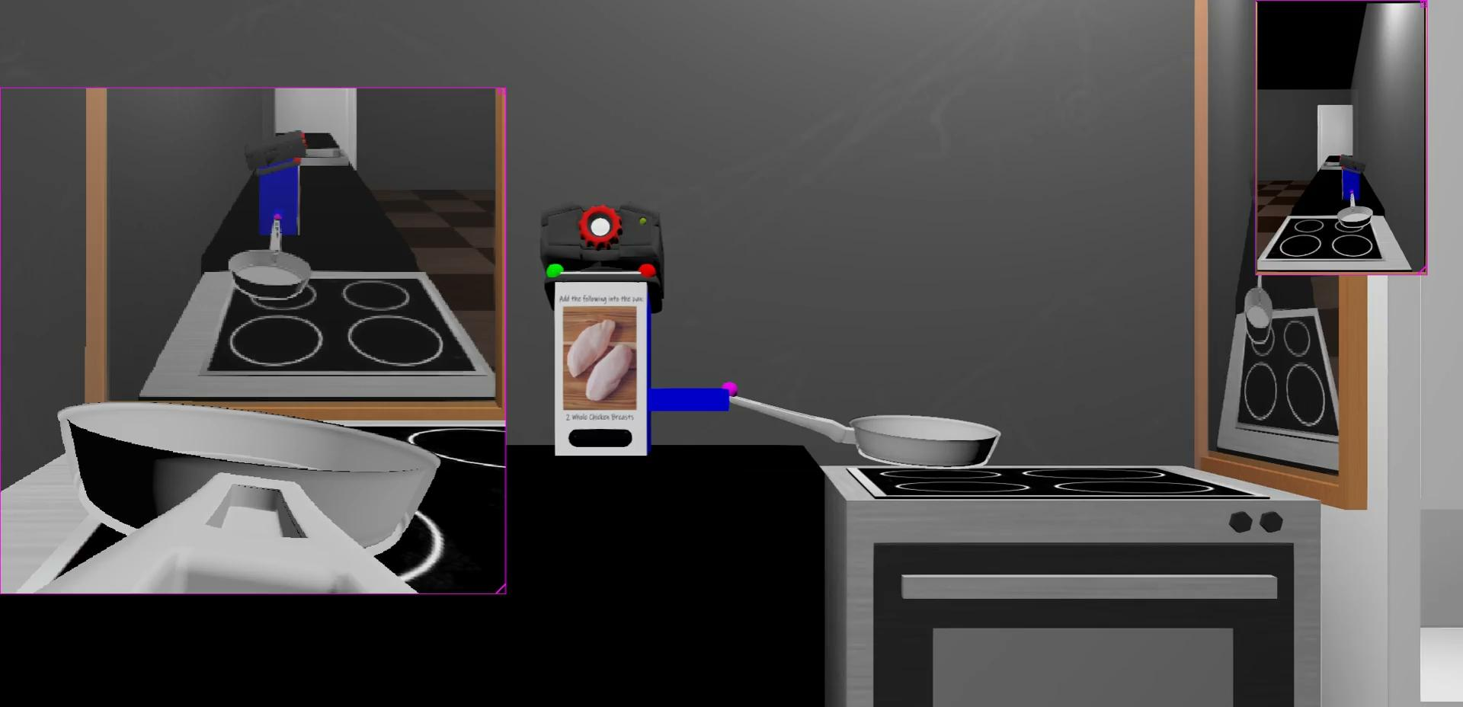
Stir-fry Motion
Notes:
Alexander Spivey

Slide 39
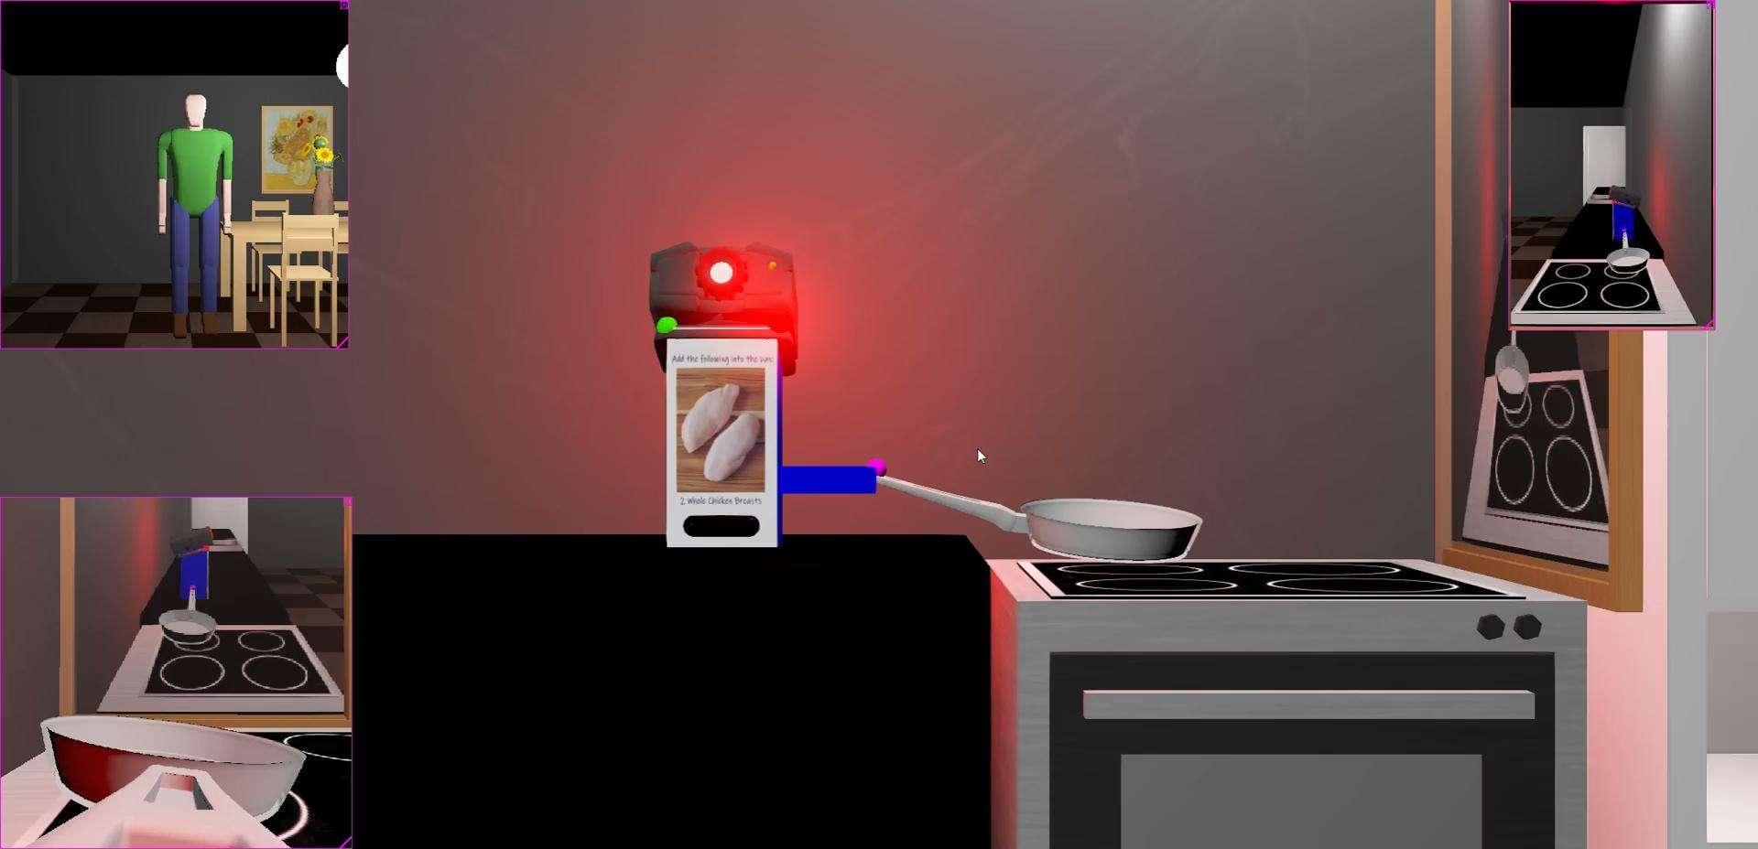
LED Showcase
Notes:
Alexander Spivey

Slide 40
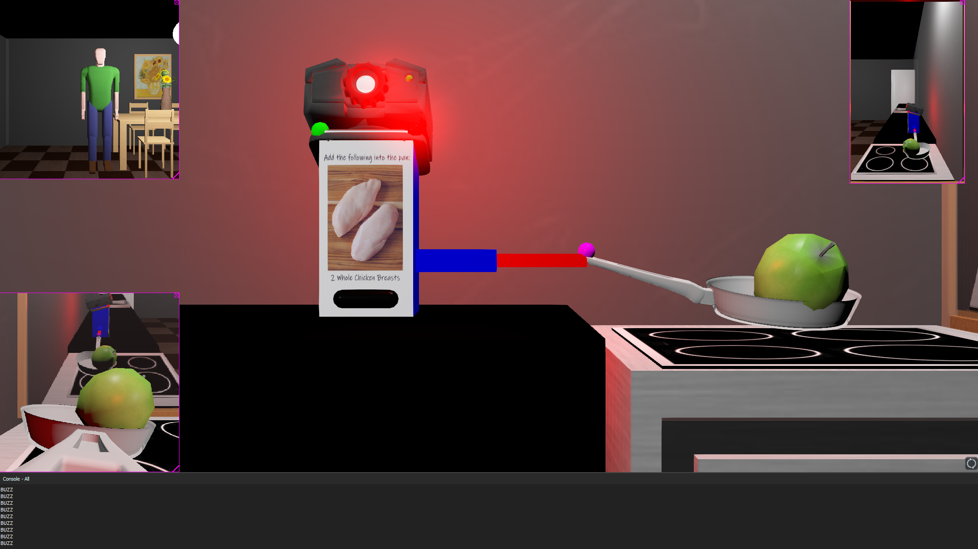
Improper Weight/Ingredient Demonstration
Notes:
Alexander Spivey

Slide 41
Section 3.
Concluding Ideas

Slide 42
Future Analysis
Combine systems to relieve obstacles
Robotic attributes to combat self-isolation
Trustworthy technological attributes for older adults
Accessibility in price and capabilities, serviceable
Connect to emergency services
Commercial applications/services
Notes:
MERRITT: Current robots that address disabilities have little overlap regarding specific functions to help relieve the main problems mentioned early in the presentation so the goal would be to combine systems to help relieve obstacles. This combination could help reduce cost as well as space taken.
MERRITT:Researchers concluded that two problem areas that were the least researched were social isolation and lack of recreation. A cooking robot with an interface to interact with the user can help with social isolation and have a cooking activity to provide a recreational activity. The interaction cooking with the robot can build the confidence of the users’ mobility and bring satisfaction in completing a task with the help of the robot.
ALEX:Due to mistrust of technology, it is imperative that future robots have attributes that are proven to be trustworthy. Researchers observed that older people responded more positively to life-simulation features, eye contact, robot personalization, and obeying commands, all undervalued elements by roboticists.
ALEX:Another important focus is the necessity to become accessible to all, not just price, but its capabilities to work with a wide range of disabilities. It is vital for future systems to be easily serviceable with a dedicated team of appropriately trained customer support to deal with all disabilities in the case of a system malfunction, which could leave users meal-less.
MERRITT:Other factors worth adding are interaction assistance, calling life alert if the system’s camera and audio sensor detect a fall, visual guidance for the visually impaired through the system’s camera and speech interface, adding multi-leveled communication for multi-impaired users (using a combination of lights, sounds, and vibrations to communicate instructions), a reminder system for medicinal purposes (such as future appointments or even medication times), and a viable communication system that would allow users to dial emergency services quickly.
ALEX:With time, commercial applications/services can be adjusted and added to be more inclusive towards differently-abled usability: such as access to Skype or Facebook Portal to easily connect with family and friends, adding a workout or physical therapy programs (that could be one on one or prerecorded) to lead the user through mobility stretches, and/or a delivery service similar to the one produced by the Chinese cooking robot. Like the aforementioned service, the goal is to connect the system to current companies like HelloFresh, Instacart, and Doordash to offer pre-packaged grocery delivery. The delivery service from the Chinese cooking robot has proven to reduce the tasks the robot system and the user has to perform by pre-portioning and pre-cutting ingredients while giving the user the ability to handpick one’s meals.

Slide 43
Conclusion for Reading Sake
This paper presented a multitude of approaches to automated cooking systems, with a heavy focus on making the system more modular, customizable, easily serviceable, small in dimension, and usable by a wide range of differently-abled users by increasing the number of users' communication components. Another heavy focus of the paper was identifying the ever-growing population of people with disabilities, age included, and the importance of cooking robots used to aid people with disabilities while still giving users independence. This review established the critical details of the machines and pointed out both flaws and “usable” components. While research for cooking technology has helped people, there is plenty of room for improvement. Future systems should embody the aforementioned traits while maintaining an affordable price.

Slide 44
“Start by doing what’s necessary; then do what’s possible; and suddenly you
are doing the impossible.”
- Francis of Assisi

Slide 45
Sources
1. United Nations. Population Facts. Department of Economic and Social Affairs: Population Division, 2015. Print.
2. M. Shishehgar, D. Kerr, and J. Blake, “A systematic review of research into how robotic technology can help older people,” Smart Health, vol. 7-8, pp. 1–18, 2018.
3. W.-T. Ma, W.-X. Yan, Z. Fu, and Y.-Z. Zhao, “A Chinese cooking robot for elderly and disabled people,” Robotica, vol. 29, no. 6, pp. 843–852, 2011.
4. T. Fulmer, “Independence-it's what older people want: Health affairs blog,” Health Affairs, 30-Nov-2015. [Online]. Available: https://www.healthaffairs.org/do/10.1377/hblog20151130.052006/full/. [Accessed: 04-Aug-2021].
5. S. Ergün, A. M. Karadeniz, S. Tanrıseven, and I. Y. Simsek, "AR-Supported Induction Cooker AR-SI: One Step before the Food Robot," 2020 IEEE International Conference on Human-Machine Systems (ICHMS), 2020, pp. 1-5, doi: 10.1109/ICHMS49158.2020.9209362.
6. G. Riva and E. Riva, “Ramcip: An advanced social robot for providing assistance at home to older people in need,” Cyberpsychology, Behavior, and Social Networking, vol. 22, no. 7, pp. 510–511, 2019.
7. Martínez, Ester & Escalona, Félix & Cazorla, Miguel. (2020). Socially Assistive Robots for Older Adults and People with Autism: An Overview. Electronics. 9. 367. 10.3390/electronics9020367.
8. Q. Zhu, V. Perera, M. Wächter, T. Asfour and M. Veloso, "Autonomous narration of humanoid robot kitchen task experience," 2017 IEEE-RAS 17th International Conference on Humanoid Robotics (Humanoids), 2017, pp. 390-397, doi: 10.1109/HUMANOIDS.2017.8246903.
9. M. Nourani, S. Kabir, S. Mohseni, and E. D. Ragan, “The Effects of Meaningful and Meaningless Explanations on Trust and Perceived System Accuracy in Intelligent Systems”, HCOMP, vol. 7, no. 1, pp. 97-105, Oct. 2019.
10. Donovan, Nancy J, and Dan Blazer. “Social Isolation and Loneliness in Older Adults: Review and Commentary of a National Academies Report.” The American journal of geriatric psychiatry : official journal of the American Association for Geriatric Psychiatry vol. 28,12 (2020): 1233-1244. doi:10.1016/j.jagp.2020.08.005
11. Pais, Ricardo et al. “Global Cognitive Impairment Prevalence and Incidence in Community Dwelling Older Adults-A Systematic Review.” Geriatrics (Basel, Switzerland) vol. 5,4 84. 27 Oct. 2020, doi:10.3390/geriatrics5040084
12. Murman, Daniel L. “The Impact of Age on Cognition.” Seminars in hearing vol. 36,3 (2015): 111-21. doi:10.1055/s-0035-1555115

Slide 46
Sources
13. Tina Minkowitz. 2006. The United Nations Convention on the Rights of Persons with Disabilities and the right to be free from nonconsensual psychiatric interventions. Syracuse J. Int’l L. & Com. 34 (2006), 405.
14. T. Kosch, K. Wennrich, D. Topp, M. Muntzinger, and A. Schmidt, “The Digital Cooking Coach: Using Visual and Auditory In-Situ Instructions to Assist Cognitively Impaired during Cooking,” Proceedings of the 12th ACM International Conference on Pervasive Technologies Related to Assistive Environments, 2019.
15. M. Inagawa, T. Takei, and E. Imanishi, “Analysis of cooking recipes written in Japanese and motion planning for cooking robot,” ROBOMECH Journal, vol. 8, no. 1, 2021.
16. R. Kojima, O. Sugiyama, and K. Nakadai, "Audio-visual scene understanding utilizing text information for a cooking support robot," 2015 IEEE/RSJ International Conference on Intelligent Robots and Systems (IROS), 2015, pp. 4210-4215, doi: 10.1109/IROS.2015.7353973.
17. S. Saha, “A comprehensive guide to convolutional neural networks,” Towards Data Science, 17-Dec-2018. [Online]. Available: https://towardsdatascience.com/a-comprehensive-guide-to-convolutional-neural-networks-the-eli5-way-3bd2b1164a53. [Accessed: 05-Aug-2021].
18. S. Mori, H. Maeta,et al., “Flow graph corpus from recipe texts,”inProc. of the 9th International Conf. on Language Resources and Evaluation, 2014.
19. Y. Yamakata, S. Imahori,et al., “Feature extraction and summarization of recipes using flow graph,” inSocial Informatics.Springer, 2013,pp. 241–254.
20. S. Fine, Y. Singer, and N. Tishby, “The hierarchical hidden markov model: Analysis and applications,”Machine learning, vol. 32, no. 1,pp. 41–62, 1998.
21. K. Junge, J. Hughes, T. G. Thuruthel and F. Iida, "Improving Robotic Cooking Using Batch Bayesian Optimization," in IEEE Robotics and Automation Letters, vol. 5, no. 2, pp. 760-765, April 2020, doi: 10.1109/LRA.2020.2965418.
22. S. Kuoppamäki, S. Tuncer, S. Eriksson, and D. McMillan, “Designing kitchen technologies for ageing in place,” Proceedings of the ACM on Interactive, Mobile, Wearable and Ubiquitous Technologies, vol. 5, no. 2, pp. 1–19, 2021.
23. H. L. Bradwell, K. J. Edwards, R. Winnington, S. Thill, and R. B. Jones, “Companion robots for older people: Importance OF user-centred design demonstrated through observations and focus groups COMPARING preferences of older people and roboticists in South West England,” BMJ Open, vol. 9, no. 9, 2019.

